Slide 1
Location Groups and Pages
8 September 2011
Notes:
Location Groups and Pages - <number>
Guidewire training materials contain Guidewire proprietary information that is subject to confidentiality and non-disclosure agreements. You agree to use the information in this manual solely for the purpose of training to implement Guidewire software solutions. You also agree not to disclose the information in this manual to third parties or copy this manual without prior written consent from Guidewire. Guidewire training may be given only by Guidewire employees or certified Guidewire partners under the appropriate agreement with Guidewire.

Slide 2
Lesson objectives
By the end of this lesson, you should be able to:
  Describe the architecture of a location group
  Configure existing location groups
  Create and modify pages
  This lesson uses the notes section for additional explanation and information.
  To view the notes in PowerPoint, choose View→Normal or View→Notes Page.
  If you choose to print the notes for the lesson, be sure to select “Print hidden slides.”
Notes:
Location Groups and Pages - <number>

Slide 3
Lesson outline
Location group basics
Location group configuration
Page configuration
Notes:
Location Groups and Pages - <number>

Slide 4
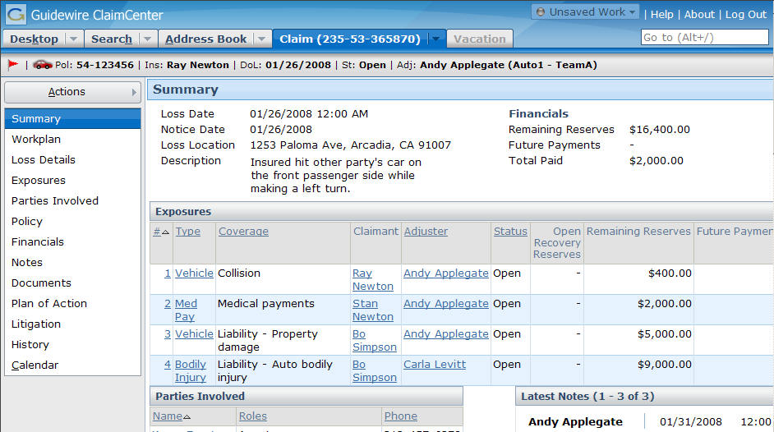
Location groups
A location group is a location that groups a set of menu links (and their associated locations), a set of menu actions, and an info bar
Info Bar
Menu Actions
Menu Links
Notes:
Location Groups and Pages - <number>
When navigating between locations in a location group, the menu links, menu actions, and info bar remain the same.
The info bar is the set of widgets that appear below the tabs but above the screen area. (In other words, they're the widgets in the horizontal gray strip just above the "Summary" label.) Some location groups do not have info bars, in which case the gray strip is not visible.
The menu links are the set of clickable labels in the side bar (such as "Summary" or "Workplan").
The menu actions are collapsed inside the Actions menu.

Slide 5
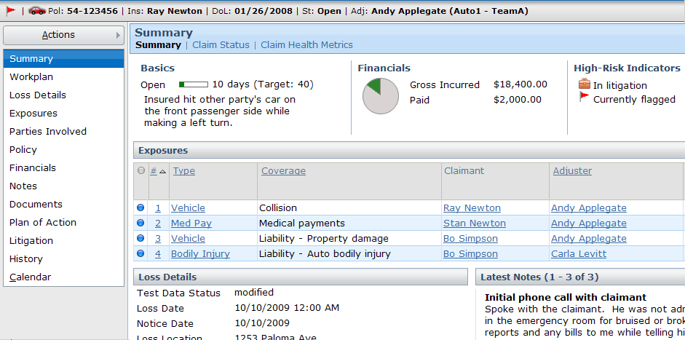
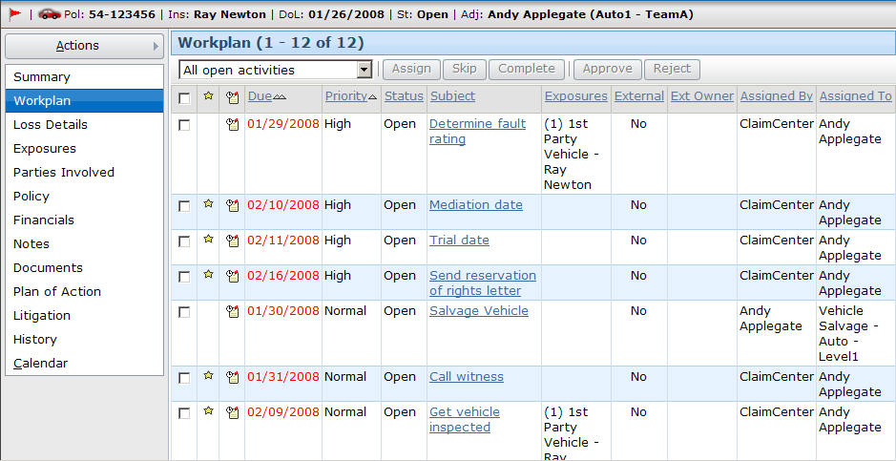
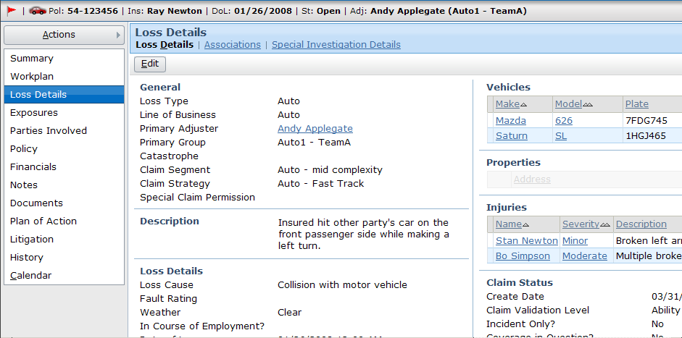
Navigating within the location group
unchanged
unchanged
Notes:
Location Groups and Pages - <number>
When you navigate from one location within the location group to another location within that same group, the contents of the screen area changes. However, note that the menu links, menu actions, and info bar remain the same.

Slide 6
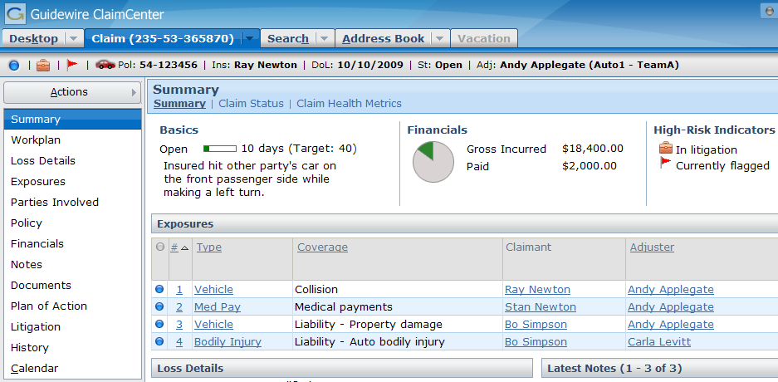
Pages
A page is a location that contains a single screen in the main frame
  Used exclusively within location groups
Notes:
Location Groups and Pages - <number>
Pages are the most common location.
Ultimately, the "groups" inside location groups are groups of pages. The contents of a location group is either pages and/or child location groups. A child location group is simply a sub-group of pages.

Slide 7
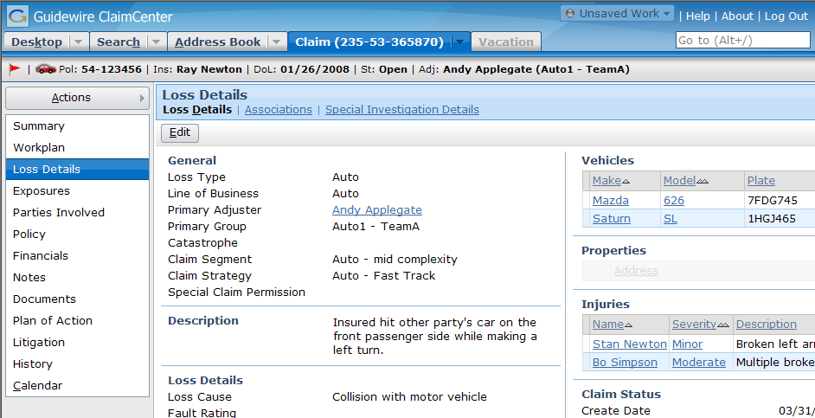
Multi-tiered hierarchy of navigation
1st level - tab bar
3rd level - screen links
2nd level -
menu links
- "location ref"
Notes:
Location Groups and Pages - <number>
Each tab in the tab bar points to a location group.
Each location group contains one or more "location refs". A location ref can point to either another location group (which is rendered as a series of screen links) or a page (which contains a screen which is rendered in the screen area).

Slide 8
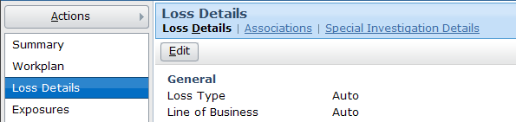
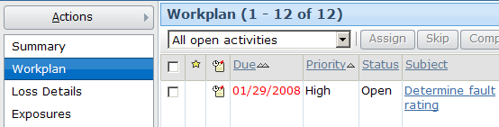
Location refs can point to location groups
Location ref can point to a location group
  Child group is rendered as screen links
  First page is rendered to fill screen area
  If the child location group has only one page, no screen links are rendered
Notes:
Location Groups and Pages - <number>
A menu link location ref (a "second level navigation") can point to either another location group or a page. When it points to another location group, the child location group is rendered as screen links.
A screen link location ref (a "third level navigation") can also point to either another location group or a page. When it points to another location group, the child location group is rendered as screen links underneath the parent screen link. (This style of navigation is technically possible but is not used anywhere in the base application.) When it points to a page, the screen contained by the page is rendered alone in the screen area.
The single-location location group is an odd construct that Guidewire does not recommend using. It is only mentioned here because there are several historical examples of it in the base product that would be confusing were it not explained.

Slide 9
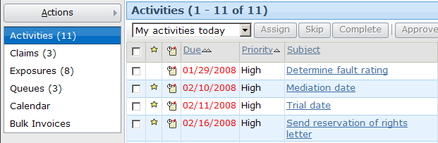
Location refs can point to pages
Location ref can point to page
  Can be done for both menu link location refs (in sidebar) and screen link location refs (at top of screen area)
Notes:
Location Groups and Pages - <number>
A menu link location ref (a "second level navigation") can point to either another location group or a page. When it points to a page, the screen contained by the page is rendered alone in the screen area.

Slide 10
Architecture of a location group
Tab
Location
Group
Location Ref
Page
screen
Location Ref
Location
Group
Location Ref
Location Ref
Page
Page
screen
screen
Notes:
Location Groups and Pages - <number>
In the base application, location groups can be divided into two categories: second-level navigations and third-level navigations. (The first level of navigation is the tab bar.)
A second-level navigation location group is a location group which a tab points to (either directly or through a forward). This type of location group is a "parent-level" group. If it has an info bar and menu actions, those elements are displayed. A second-level navigation location group can contain pages and other location groups.
A third-level navigation location group is a location group which some other location group contains. This type of location group is a "child-level" group. It typically does not have an info bar or menu actions. (If it does, those elements are not displayed.) A second-level navigation location group typically contains only pages. It can contain other location groups (and the grandchild locations are rendered as links below the screen link), but there is no instance of this in the base application.
A location group contains location refs. Each location ref points to either a page or another location group. When a location ref points to a page, clicking the label of the location ref (the menu link) renders the page, which renders the associated screen. When a location ref points to a location group, clicking the label of the location ref (the menu link) renders the location group as screen links. The first location ref's page is also rendered.

Slide 11
Location groups in the base application
Desktop.pcf
Search.pcf
Address
Book.pcf
Claim.pcf
Team.pcf
(if user can view team)
DashboardGroup.pcf
(if user can
view any
executive
dashboard)
Admin.pcf
(if user can view any admin screen)
Vacation.pcf
(if user is backup for someone on vacation)
Notes:
Location Groups and Pages - <number>
Fortunately, the five primary location groups visible to end users (Desktop, Search, Address Book, Claim, and Vacation) are in PCF files with names identical to their English tab label.

Slide 12
Location group and page configuration
Two levels of configuration
  Location-group-level
    Entry point and navigation to location group
    Permissions to visit
    Location refs
  Page-level
    Screen that a page renders
    Page logic (visibility, editability)
    Page labels
Location
Group
Location Ref
Location
Group
Page
Location Ref
screen
Notes:
Location Groups and Pages - <number>
The next section of this lesson discusses location-group-level configuration. The section after that discusses page-level configuration.

Slide 13
Lesson outline
Location group basics
Location group configuration
Page configuration
Notes:
Location Groups and Pages - <number>

Slide 14
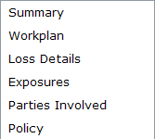
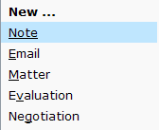
Information in location group PCF File
Claim.pcf
info bar
Entry Point
menu actions
Location group PCF file contains:
  Entry point and required objects
  "Location refs" which point to pages or child location groups
  Attributes that point to separate files for info bar and menu actions
Notes:
Location Groups and Pages - <number>

Slide 15
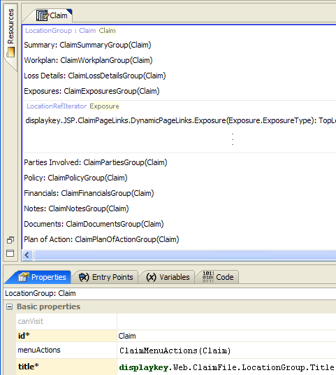
Example PCF file: Claim
Location Refs declared in top pane
Tabs, including:
Properties (menu actions,
info bar)
Entry Point (entry points)
Notes:
Location Groups and Pages - <number>
The PCF file for a location group consists of location refs. Each location ref points to a page or child location group. The location group attributes are specified on the tabs at the bottom.

Slide 16
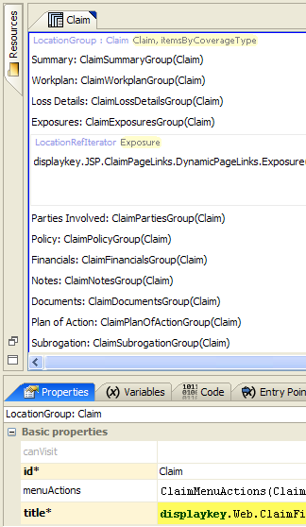
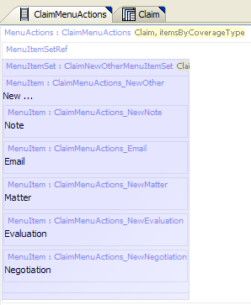
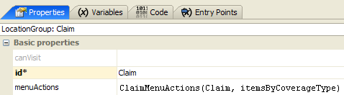
Location group menu actions
Notes:
Location Groups and Pages - <number>
The location group's menuActions property specifies the file to use for contents of the Actions menu.

Slide 17
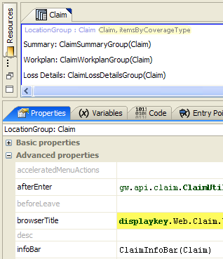

Location group info bar
Notes:
Location Groups and Pages - <number>
The location group's infoBar property specifies the file to use for contents of the info bar.

Slide 18
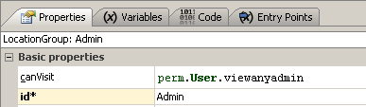
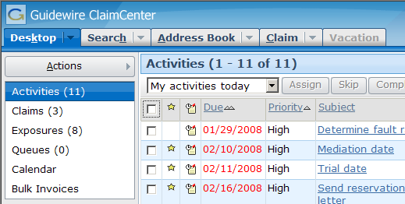
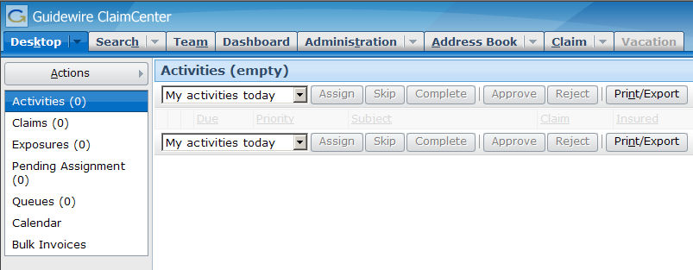
canVisit property
false
true
Notes:
Location Groups and Pages - <number>
The canVisit attribute determines whether a user can visit the location group. If blank, the attribute evaluates to true. When the attribute evaluates to false, the tab is not rendered in the user interface. (For example, if perm.User.viewanyadmin returns false (which means the user does not have permissions to view any Admin screen), the Administration tab is not rendered for that user.
Location groups visibility can also be controlled by the visible attribute of the Tab whose action navigates to the Location group. When set to false, it will prevent the user from being able to access the location (unless another navigation link were available).
Single-screen locations and wizards also have a canEdit attribute. Location groups do not. Editablility for location groups is controlled at the level of each page.

Slide 19
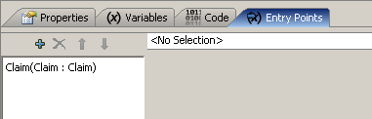
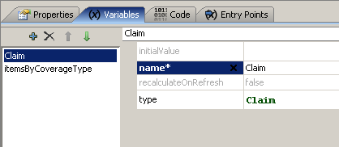
Entry points
Recall that entry point is name for location used by navigation widgets
Each object
expected in each entry
point must
be declared on
variable tab
entry point name
object
name
object
type
Notes:
Location Groups and Pages - <number>
In the example above, the Claim location group has an entry point name of "Claim". It expects a single object of type claim which is referred to within the PCF page as "Claim". For the purposes of instructional clarification, the location group could also have been declared as "ClaimLG(aClaim: Claim)". In this case, the entry point name is "ClaimLG" (which is how any widget navigating to this location would need to reference it). It would expect an object of type Claim which is referred to within the PCF file as "aClaim".
Important: If your variable name is something other than "Claim", you will need to add to the Page’s “parent” attribute the explicit reference to the parent location with the variable name as the argument. For example, if your page’s variable was “aClaim”, your parent attribute would be “Claim(aClaim)”.

Slide 20


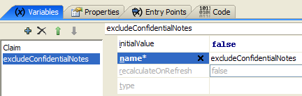
Multiple entry points
Location groups can have multiple entry points with different signatures
Notes:
Location Groups and Pages - <number>
Locations can have multiple entry points. This is useful when a single location can be referenced from different places with different known or required pieces of information. In the example above, the Claim Summary location group has entry points for normal operations and for the case where ClaimCenter should not display confidential notes. The excludeConfidentialNotes variable defaults to "false" in the typical situation, but it can be passed to the location group with the value set to "true", in which case the confidential notes will be hidden from display.

Slide 21



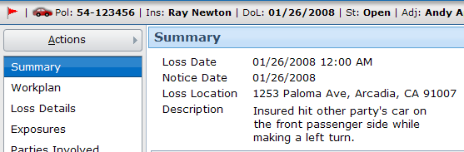
Navigating to location groups
Navigation uses "go()"
Syntax:
  EntryPointOfLocation.go(objectsToPass)
Notes:
Location Groups and Pages - <number>
Most navigation widgets have an action attribute, which defines where to navigate to when the widget is clicked. The syntax for an action attribute which navigates to a location is:
pcf.LocationEntryPoint.method(objectList), where
LocationEntryPoint is (one of) the location entry point(s) defined on the destination location's Entry Points tab.
method is the method used to navigate to the location (which, for location groups, is almost always "go").
objectList is a comma-delimited list of zero to many objects. This list must match the number of objects and the type which are expected by the location entry point.
In the example above, the CaseID cell (which displays the claim number) has an action attribute of Claim.go(ActivityDesktopView.Claim). This means the widget navigates to the location with an entry point of "Claim" (which corresponds to the Claim location group) using the go method (which means the location is rendered in the screen area with no "Return to..." link) and the claim associated to the ActivityDesktopView object is passed to the location.

Slide 22
Lesson outline
Location group basics
Location group configuration
Page configuration
Notes:
Location Groups and Pages - <number>

Slide 23
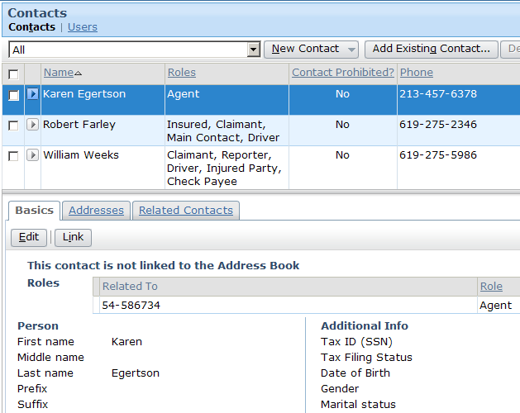
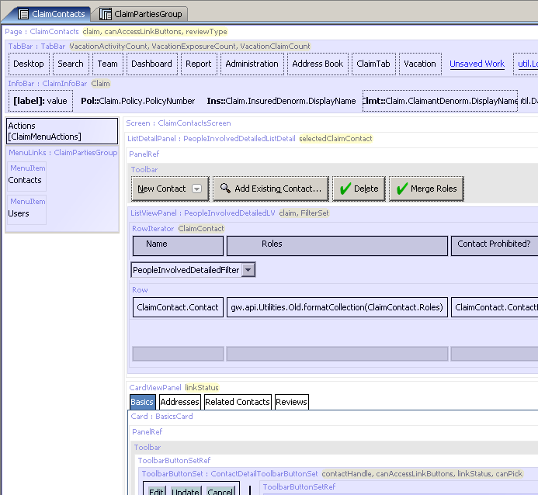
Page PCFs
Page PCF file contains references to all embedded content
Notes:
Location Groups and Pages - <number>
A page is actually very simple, as it typically contains just a screen with panel references to the views to embed within it. However, the rendering of the page in Studio can look somewhat complex, as all the embedded elements are visible in the page.

Slide 24

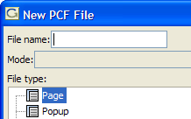
Create a new page
Right-click on "Page Configuration
(PCF)" folder or any subfolder
  Select New→PCF File
  Select "Page" file type
  Note there is no file suffix enforcement for pages

Slide 25
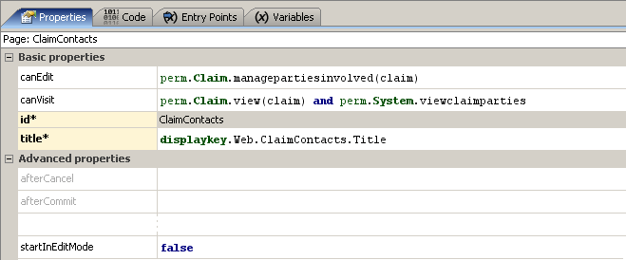
canVisit property
Notes:
Location Groups and Pages - <number>
Similar to a location group's canVisit attribute, a user can see links to (and therefore navigate to) a page only if canVisit evaluates to true.

Slide 26
Edit mode
A page is either in readonly or edit mode
  If canEdit evaluates to true, the page has Edit/Update buttons
  If startInEditMode is true, then page renders in Edit mode
Notes:
Location Groups and Pages - <number>
If a given page's canEdit mode evaluates to false, then the page appears only in readonly mode, even if startInEditMode is set to true.

Slide 27
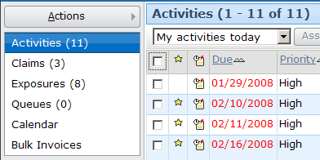
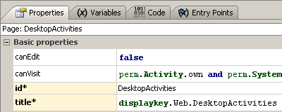
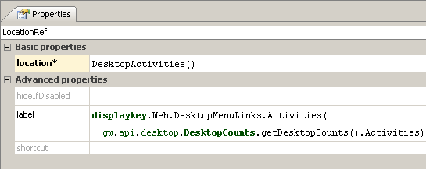
Page-related labels
Title bar label comes from page's title property
Menu link label comes from Location Ref label property
Notes:
Location Groups and Pages - <number>
The location ref's label attribute references the display key "Web.DesktopMenuLinks.Activities", which in the English locale is set to "Activities ({0})". The "{0}" is a placeholder for a value passed to the display key. In this case, the value that is passed is the return value of the function gw.api.desktop.DesktopCounts.getDesktopCounts().Activities, which returns the number of activities assigned to the given user.
The page's title attribute references the display key "Web.DesktopActivities", which in the English locale is set to "{JSP.TabBar.LinkButton.OpenActivities}“, which in turn references another display key {Term.Activites.Proper}. However this value can (and is in example shown in the slide) overridden by the contained Screen element’s special child TitleBar widget which itself has an attribute called appendListViewPaging set to true. This returns one of two strings, either "Activities (X - Y of Z)", where X and Y are equal to the "set numbers" of the first and last of activities displayed on the list view and Z is equal to the total number of activities, or "Activities (empty)" if there are no activities in the list.

Slide 28

Entry points
Entry points for pages look the same as entry points for location groups
  Entry point is name for page used by navigation widgets
  Each object expected in each entry point must be declared on variable tab
Notes:
Location Groups and Pages - <number>
Important: If your variable name is something other than "Claim", you will need to add to the Page’s “parent” attribute the explicit reference to the parent location with the variable name as the argument. For example, if your page’s variable was “aClaim”, your parent attribute would be “Claim(aClaim)”.

Slide 29
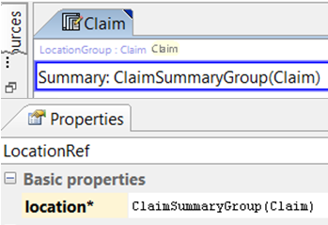

Navigate to pages or other location groups from location refs
Claim Location Group's Location Ref
When clicked, where
do I navigate to?
Notes:
Location Groups and Pages - <number>
Each location ref has a location attribute. This specifies the entry point of the location which the location ref points to. The location is typically a child location group or a page. If the destination location group or page requires one or more objects, then the location attribute must specify which objects to pass.

Slide 30
Lesson objectives review
You should now be able to:
  Describe the architecture of a location group
  Configure existing location groups
  Create and modify pages
Notes:
Location Groups and Pages - <number>

Slide 31
Review questions
When you navigate between locations in a location group:
  What changes?
  What remains the same?
What two things can a location ref point to?
How does ClaimCenter visually render a location group within a location group?
What happens if a location group's canVisit attribute evaluates to false?
When viewing a location group PCF file in Studio, which Studio tab specifies how to navigate to it?
Notes:
Location Groups and Pages - <number>
Answers
1. a) The contents of the screen area changes. b) The menu links, menu actions, and info bar remain the same.
2. A child location group or a page.
3. It renders the child location group as screen links.
4. When a location group's canVisit attribute is false, the location group is not rendered in the user interface. For example, if the location group appears on a tab, the tab is not rendered at all.
5. The Entry Points tab. This identifies the "navigation name" of the location group as well as any objects needed when navigating to it.

Slide 32
Notices
Copyright © 2001-2011 Guidewire Software, Inc. All Rights Reserved.
Guidewire, Guidewire Software, Guidewire ClaimCenter, Guidewire PolicyCenter, Guidewire BillingCenter, Guidewire Reinsurance Management, Guidewire ContactManager, Guidewire Vendor Data Management, Guidewire Client Data Management, Guidewire InsuranceSuite, Guidewire ContactCenter, Guidewire Studio, Gosu, Deliver Insurance Your Way, and the Guidewire logo are trademarks or registered trademarks of Guidewire Software, Inc. in the United States and/or other countries.
This material is Guidewire proprietary and confidential. The contents of this material, including product architecture details and APIs, are considered confidential and are fully protected by customer licensing confidentiality agreements and signed Non-Disclosure Agreements (NDAs).
This file and the contents herein are the property of Guidewire Software, Inc. Use of this course material is restricted to students officially registered in this specific Guidewire-instructed course, or for other use expressly authorized by Guidewire. Replication or distribution of this course material in electronic, paper, or other format is prohibited without express permission from Guidewire.
    Guidewire products are protected by one or more of the following patents: U.S. Patent No. 7,885,831; U.S. Patent No. 7,788,296.
Notes:
Introduction to Guidewire Configuration - <number>

